Slide 1
CSC 480: Artificial Intelligence
Franz J. Kurfess
Professor
Computer Science Department
California Polytechnic State University
San Luis Obispo, CA, U.S.A.

Slide 2
Revisions
2009-10-14
split this chapter into two parts, to prepare for the transition to the 3rd edition
added some pictures and diagrams
This set of slides is the first one of the part on search algorithms.

Slide 3
Course Overview
Knowledge and Reasoning
reasoning agents
propositional logic
predicate logic
knowledge-based systems
Learning
learning from observation
neural networks
Conclusions
Introduction
Intelligent Agents
Search
problem solving through search
uninformed search
informed search
Games
games as search problems

Slide 4
Logistics Project
Moodle: Artificial Intelligence (Kurfess)
enrollment key: AI-MUAS-S15
groups being set up for project teams
project description
project overview
tentative schedule
features, requirements, evaluation criteria

Slide 5
Logistics
Lab and Homework Assignments
Lab 2 due tonight (23:59); demos during the lab time
Lab 3: implementation of breadth-first, depth-first search
Quizzes
Quiz 2
Available Tue, April 14, all day (0:00 - 23:59)
longer availability of quizzes?

Slide 6
Logistics
Introductions
Course Materials
textbook
handouts
Web page
CourseInfo/Blackboard System
Term Project
Lab and Homework Assignments
Exams
Grading

Slide 7
Chapter Overview Search
Motivation
Objectives
Search as Problem-Solving
problem formulation
problem types
Uninformed Search
breadth-first
depth-first
uniform-cost search
depth-limited search
iterative deepening
bi-directional search
Informed Search
best-first search
search with heuristics
memory-bounded search
iterative improvement search
Non-Traditional Search
local search and optimization
constraint satisfaction
search in continuous spaces
partially observable worlds
Important Concepts and Terms
Chapter Summary

Slide 8
Motivation and Objectives
Pre-Test
Motivation
Objectives
Evaluation Criteria

Slide 9
Pre-Test
basic search strategies
depth-first
breadth-first
exercise
apply depth-first to finding a path from this building to your favorite “feeding station” (Lighthouse, Avenue, Ciao)
is this task sufficiently specified
is success guaranteed
how long will it take
could you remember the path
how good is the solution
Notes:
find out about the background of the participants
establish formal prerequisites
sensitize participants to potential gaps in their background knowledge
affirm the students’ qualifications

Slide 10
Motivation
search strategies are important methods for many approaches to problem-solving
the use of search requires an abstract formulation of the problem and the available steps to construct solutions
search algorithms are the basis for many optimization and planning methods

Slide 11
Objectives
formulate appropriate problems as search tasks
states, initial state, goal state, successor functions (operators), cost
know the fundamental search strategies and algorithms
uninformed search
breadth-first, depth-first, uniform-cost, iterative deepening, bi-directional
informed search
best-first (greedy, A*), heuristics, memory-bounded, iterative improvement
evaluate the suitability of a search strategy for a problem
completeness, time & space complexity, optimality

Slide 12
Evaluation Criteria
formulation of a problem as search task
basic search strategies
important properties of search strategies
selection of search strategies for specific tasks
development of task-specific variations of search strategies

Slide 13
Background
What is Search in AI?
Problem-Solving and Search
Terminology

Slide 14
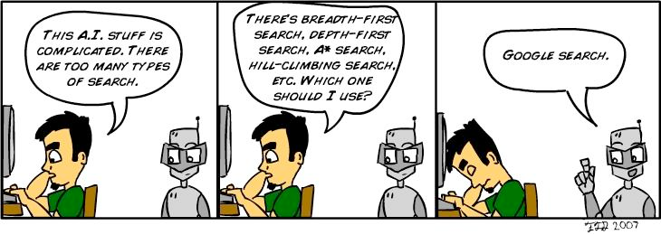
Lab 10 Submission: AI and Humor -> Description of a Typical AI Student
Bassem Tossoun - Tuesday, November 27, 2012, 9:23 PM
http://blog.lib.umn.edu/torre107/si/pics/superficialintelligence2.jpg

Slide 15
Search as Problem-Solving Strategy
many problems can be viewed as reaching a goal state from a given starting point
often there is an underlying state space that defines the problem and its possible solutions in a more formal way
the space can be traversed by applying a successor function (operators) to proceed from one state to the next
if possible, information about the specific problem or the general domain is used to improve the search
experience from previous instances of the problem
strategies expressed as heuristics
simpler versions of the problem
constraints on certain aspects of the problem
Notes:
anecdote, demonstration, example to informally introduce the topic
evoke the participants’ interest and curiosity
set the stage for the more formal introduction
make students more comfortable

Slide 16
Examples
getting from home to Cal Poly
start: home on Clearview Lane
goal: Cal Poly CSC Dept.
operators: move one block, turn
loading a moving truck
start: apartment full of boxes and furniture
goal: empty apartment, all boxes and furniture in the truck
operators: select item, carry item from apartment to truck, load item
getting settled
start: items randomly distributed over the place
goal: satisfactory arrangement of items
operators: select item, move item

Slide 17
Problem-Solving Agents
agents whose task it is to solve a particular problem
goal formulation
what is the goal state
what are important characteristics of the goal state
how does the agent know that it has reached the goal
are there several possible goal states
are they equal or are some more preferable
problem formulation
what are the possible states of the world relevant for solving the problem
what information is accessible to the agent
how can the agent progress from state to state

Slide 18
Problem Formulation
formal specification for the task of the agent
goal specification
states of the world
actions of the agent
identify the type of the problem
what knowledge does the agent have about the state of the world and the consequences of its own actions
does the execution of the task require up-to-date information
sensing is necessary during the execution

Slide 19
Problem Types
single-state problems
accessible world and knowledge of its actions allow the agent to know which state it will be in after a sequence of actions
multiple-state problems
the world is only partially accessible, and the agent has to consider several possible states as the outcome of a sequence of actions
contingency problems
at some points in the sequence of actions, sensing may be required to decide which action to take; this leads to a tree of sequences
exploration problems
the agent doesn’t know the outcome of its actions, and must experiment to discover states of the world and outcomes of actions

Slide 20
Well-Defined Problems
problems with a readily available formal specification
initial state
starting point from which the agent sets out
actions (operators, successor functions)
describe the set of possible actions
state space
set of all states reachable from the initial state by any sequence of actions
path
sequence of actions leading from one state in the state space to another
goal test
determines if a given state is the goal state

Slide 21
Well-Defined Problems (cont.)
solution
path from the initial state to a goal state
search cost
time and memory required to calculate a solution
path cost
determines the expenses of the agent for executing the actions in a path
sum of the costs of the individual actions in a path
total cost
sum of search cost and path cost
overall cost for finding a solution

Slide 22
Selecting States and Actions
states describe distinguishable points or periods during the problem-solving process
dependent on the task and domain
actions move the agent from one state to another one
an operator is applied to the initial state and takes the agent to the successor state
dependent on states, capabilities of the agent, and properties of the environment
choice of suitable states and operators
can make the difference between a problem that can or cannot be solved (in principle, or in practice)

Slide 23
Example: Commute
Home => MUAS
states
locations:
obvious: buildings that contain your home, MUAS Computer Science building
more difficult: intermediate states
public transit: stops (bus, street car, U-Bahn, S-Bahn)
walking: ??
bicycling: ??
car: ??
environment-centric states
e.g., public transit stops
agent-centric states
moving, turning, resting, ...
operators
depend on the choice of states
e.g. move_one_block
abstraction is necessary to omit irrelevant details
valid: can be expanded into a detailed version
useful: easier to solve than in the detailed version

Slide 24
Search Example:
Traveling by Car
Route finding: Starting Point => Goal Point
focus on
communities, landmarks
highways, streets, intersections
street addresses
constraints
one-way, avoid highways/ferries/toll roads, scenic vs. direct, …
traffic considerations

Slide 25
Search Example:
Traveling by Train
Route finding: Starting Station => Goal Station
focus on railway network
train stations
constraints
train type: ICE vs. regional
passenger special needs: bicycle transport
traffic considerations

Slide 26
Example: From Home to Cal Poly
states
locations:
obvious: buildings that contain your home, Cal Poly CSC dept.
more difficult: intermediate states
blocks, street corners, sidewalks, entryways, ...
continuous transitions
agent-centric states
moving, turning, resting, ...
operators
depend on the choice of states
e.g. move_one_block
abstraction is necessary to omit irrelevant details
valid: can be expanded into a detailed version
useful: easier to solve than in the detailed version

Slide 27
Single-state problem formulation
A problem is defined by four items:
initial state e.g., "at Arad"
actions or successor function S(x) = set of action–state pairs
e.g., S(Arad) = {<Arad → Zerind, Zerind>, … }
goal test, can be
explicit, e.g., x = "at Bucharest"
implicit, e.g., Checkmate(x)
path cost (additive)
e.g., sum of distances, number of actions executed, etc.
c(x,a,y) is the step cost, assumed to be ≥ 0
A solution is a sequence of actions leading from the initial state to a goal state
http://aima.eecs.berkeley.edu/slides-ppt/

Slide 28
Selecting a state space
Real world is absurdly complex
state space must be abstracted for problem solving
(Abstract) state = set of real states
(Abstract) action = complex combination of real actions
e.g., "Arad -> Zerind" represents a complex set of possible routes, detours, rest stops, etc.
For guaranteed realizability, any real state "in Arad“ must get to some real state "in Zerind"
(Abstract) solution =
set of real paths that are solutions in the real world
Each abstract action should be "easier" than the original problem
http://aima.eecs.berkeley.edu/slides-ppt/

Slide 29
Example Problems for Search
Toy Problems
Real-World Problems

Slide 30
Example Problems
toy problems
vacuum world
8-puzzle
8-queens
cryptarithmetic
vacuum agent
missionaries and cannibals
real-world problems
route finding
touring problems
traveling salesperson
VLSI layout
robot navigation
assembly sequencing
Web search

Slide 31
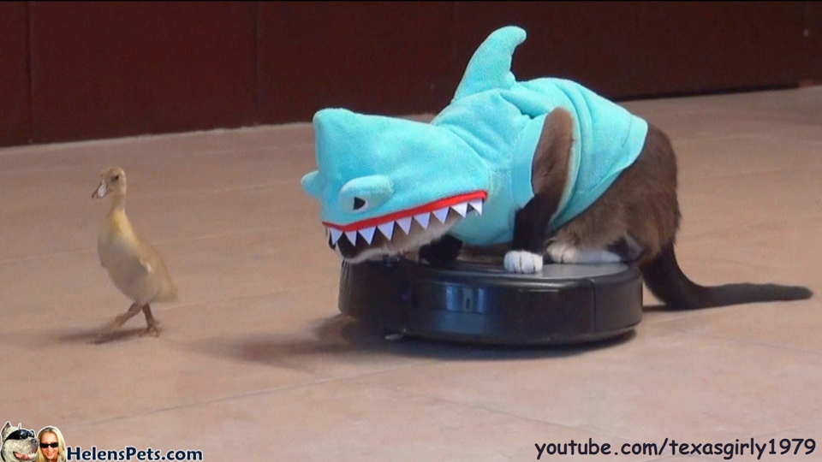
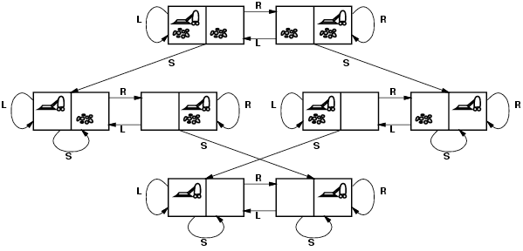
Example: Vacuum World
http://www.google.com/url?sa=i&source=images&cd=&cad=rja&docid=Pz3Wn3dXJTa6wM&tbnid=wU_RhC16EqguGM:&ved=&url=http%3A%2F%2Fwww.youtube.com%2Fwatch%3Fv%3DOf2HU3LGdbo&ei=ihlSUpO9KuvMigKJuYCADw&psig=AFQjCNHl8trHQoemZh0VyNhoWvcDwSatMQ&ust=1381198602732118

Slide 32
Simple Vacuum World
states
two locations
dirty, clean
initial state
any legitimate state
successor function (operators)
left, right, suck
goal test
all squares clean
path cost
one unit per action
Properties: discrete locations, discrete dirt (binary), deterministic

Slide 33
More Complex Vacuum Agent
states
configuration of the room
dimensions, obstacles, dirtiness
initial state
locations of agent, dirt
successor function (operators)
move, turn, suck
goal test
all squares clean
path cost
one unit per action
Properties: discrete locations, discrete dirt, deterministic, d * 2^{n} states for dirt degree d,n locations

Slide 34
Vacuum World Example
from the AIMA textbook slides
conversion from PowerPoint to Keynote

Slide 35
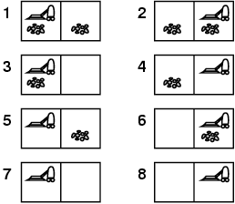
Example: vacuum world
Single-state, start in #5. Solution?
http://aima.eecs.berkeley.edu/slides-ppt/

Slide 36
Example: vacuum world
Single-state, start in #5. Solution? [Right, Suck]
Sensorless, start in {1,2,3,4,5,6,7,8} e.g., Right goes to {2,4,6,8} Solution?
http://aima.eecs.berkeley.edu/slides-ppt/

Slide 37
Example: vacuum world
Sensorless, start in {1,2,3,4,5,6,7,8} e.g., Right goes to {2,4,6,8} Solution? [Right,Suck,Left,Suck]
Contingency
Nondeterministic: Suck may dirty a clean carpet
Partially observable: location, dirt at current location.
Percept: [L, Clean], i.e., start in #5 or #7 Solution?
http://aima.eecs.berkeley.edu/slides-ppt/

Slide 38
Example: vacuum world
Sensorless, start in {1,2,3,4,5,6,7,8} e.g., Right goes to {2,4,6,8} Solution? [Right,Suck,Left,Suck]
Contingency
Nondeterministic: Suck may dirty a clean carpet
Partially observable: location, dirt at current location.
Percept: [L, Clean], i.e., start in #5 or #7 Solution? [Right, if dirt then Suck]
http://aima.eecs.berkeley.edu/slides-ppt/

Slide 39
Vacuum world state space graph
states?
actions?
goal test?
path cost?
http://aima.eecs.berkeley.edu/slides-ppt/

Slide 40
Vacuum world state space graph
states? integer dirt and robot location
actions? Left, Right, Suck
goal test? no dirt at all locations
path cost? 1 per action
http://aima.eecs.berkeley.edu/slides-ppt/

Slide 41
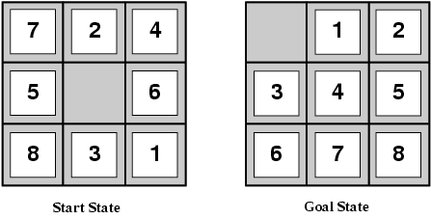
Example: The 8-puzzle
states?
actions?
goal test?
path cost?
[Note: optimal solution of n-Puzzle family is NP-hard]
http://aima.eecs.berkeley.edu/slides-ppt/

Slide 42
8-Puzzle
states
location of tiles (including blank tile)
properties of tiles (numbers, letters, image parts, …)
initial state
any legitimate configuration
successor function (operators)
move tile
alternatively: move blank
goal test
specific legitimate configuration of tiles
particular arrangement of tiles
may reflect ordering relations, words, image
path cost
one unit per move
Properties: abstraction leads to discrete configurations, discrete moves,
deterministic
9!/2 = 181,440 reachable states

Slide 43

Example: n-queens
Put n queens on a n × n board with no two queens on the same row, column, or diagonal
see also Wikipedia Eight Queens Puzzle

Slide 44
8-Queens
Incremental Approach
start with an empty board
add queens one by one
no violation of constraints
different row, column, diagonal from sitting queens
incremental formulation
states
arrangement of up to 8 queens on the board
initial state
empty board
successor function (operators)
add a queen to any square
goal test
all queens on board
no queen attacked
path cost
irrelevant (all solutions equally valid)
Properties: 3*1014 possible sequences; can be reduced to 2,057

Slide 45
8-Queens
Complete-State Approach
start with a full board
all n queens placed on the board
conflicts are to be expected
try to find a better configuration
reduced number of conflicts
complete-state formulation
states
arrangement of 8 queens on the board
initial state
all 8 queens on board
successor function (operators)
move a queen to a different square
goal test
no queen attacked
path cost
irrelevant (all solutions equally valid)
Properties: good strategies can reduce the number of possible sequences considerably

Slide 46
8-Queens
incremental formulation
states
arrangement of up to 8 queens on the board
initial state
empty board
successor function (operators)
add a queen to any square
goal test
all queens on board
no queen attacked
path cost
irrelevant (all solutions equally valid)
Properties:
3*1014 possible sequences; can be reduced to 2,057
complete-state formulation
states
arrangement of 8 queens on the board
initial state
all 8 queens on board
successor function (operators)
move a queen to a different square
goal test
no queen attacked
path cost
irrelevant (all solutions equally valid)
Properties:
good strategies can reduce the number of possible sequences considerably

Slide 47
8-Queens Refined
simple solutions may lead to very high search costs
64 fields, 8 queens ==> 648 possible sequences
more refined solutions trim the search space, but may introduce other constraints
place queens on “unattacked” places
much more efficient
may not lead to a solution depending on the initial moves
move an attacked queen to another square in the same column, if possible to an “unattacked” square
much more efficient

Slide 48
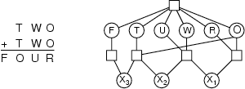
Crypt-arithmetic
states
puzzle with letters and digits
initial state
only letters present
successor function (operators)
replace all occurrences of a letter by a digit not used yet
goal test
only digits in the puzzle
calculation is correct
path cost
all solutions are equally valid

Slide 49
Missionaries and Cannibals
states
number of missionaries, cannibals, and boats on the banks of a river
illegal states
missionaries are outnumbered by cannibals on either bank
initial states
all missionaries, cannibals, and boats are on one bank
successor function (operators)
transport a set of up to two participants to the other bank
{1 missionary} | { 1cannibal} | {2 missionaries} | {2 cannibals} | {1 missionary and 1 cannibal}
goal test
nobody left on the initial river bank
path cost
number of crossings
also known as “goats and cabbage”, “wolves and sheep”, etc

Slide 50
Route Finding
states
locations
initial state
starting point
successor function (operators)
move from one location to another
goal test
arrive at a certain location
path cost
may be quite complex
money, time, travel comfort, scenery, ...

Slide 51
Traveling Salesperson
states
locations / cities
illegal states
each city may be visited only once
visited cities must be kept as state information
initial state
starting point
no cities visited
successor function (operators)
move from one location to another one
goal test
all locations visited
agent at the initial location
path cost
distance between locations

Slide 52
VLSI Layout
states
positions of components, wires on a chip
initial state
incremental: no components placed
complete-state: all components placed (e.g. randomly, manually)
successor function (operators)
incremental: place components, route wire
complete-state: move component, move wire
goal test
all components placed
components connected as specified
path cost
may be complex
distance, capacity, number of connections per component

Slide 53
Robot Navigation
states
locations
position of actuators
initial state
start position (dependent on the task)
successor function (operators)
movement, actions of actuators
goal test
task-dependent
path cost
may be very complex
distance, energy consumption

Slide 54
Assembly Sequencing
states
location of components
initial state
no components assembled
successor function (operators)
place component
goal test
system fully assembled
path cost
number of moves

Slide 55
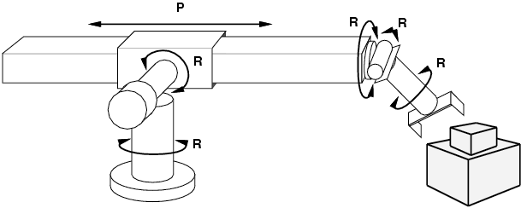
Example: robotic assembly
states?: real-valued coordinates of robot joint angles parts of the object to be assembled
actions?: continuous motions of robot joints
goal test?: complete assembly
path cost?: time to execute
http://aima.eecs.berkeley.edu/slides-ppt/

Slide 56
Search Methods
Terminology
Search and Graphs

Slide 57
Searching for Solutions
traversal of the search space
from the initial state to a goal state
legal sequence of actions as defined by successor function (operators)
general procedure
check for goal state
expand the current state
determine the set of reachable states
return “failure” if the set is empty
select one from the set of reachable states
move to the selected state
a search tree is generated
nodes are added as more states are visited

Slide 58
Search Terminology
search tree
generated as the search space is traversed
the search space itself is not necessarily a tree, frequently it is a graph
the tree specifies possible paths through the search space
expansion of nodes
as states are explored, the corresponding nodes are expanded by applying the successor function
this generates a new set of (child) nodes
the fringe (frontier) is the set of nodes not yet visited
newly generated nodes are added to the fringe
search strategy
determines the selection of the next node to be expanded
can be achieved by ordering the nodes in the fringe
e.g. queue (FIFO), stack (LIFO), “best” node w.r.t. some measure (cost)

Slide 59
Example: Graph Search
describes the search (state) space
each node represents one state in the search space
e.g. a city to be visited in a routing or touring problem
additional information
names and properties for the states (e.g. S, 3)
links between nodes, specified by the successor function
properties for links (distance, cost, name, ...)
A
4
1
D
3
1
1
1
3
S
3
5
C
2
2
G
0
1
3
3
4
B
2
E
1
2

Slide 60
Graph and Tree
A
4
1
D
3
the tree is generated by traversing the graph
the same node in the graph may appear repeatedly in the tree
the arrangement of the tree depends on the traversal strategy (search method)
the initial state becomes the root node of the tree
in the fully expanded tree, the goal states are the leaf nodes
cycles in graphs may result in infinite branches
1
1
1
3
S
3
5
C
2
2
G
0
1
3
3
4
B
2
E
1
2
S
3
1
5
1
A
4
C
2
B
2
1
1
1
2
3
3
2
D
3
C
2
D
3
G
0
E
1
C
2
4
E
1
3
1
2
3
3
4
1
2
3
4
G
0
D
3
G
0
E
1
G
0
G
0
D
3
G
0
E
1
G
0
3
4
3
4
G
0
G
0
G
0
G
0

Slide 61
Breadth First Search
A
4
1
D
3
1
1
1
3
S
3
5
C
2
2
G
0
1
3
3
4
B
2
E
1
2
S
3
1
5
1
A
4
C
2
B
2
1
1
1
2
3
3
3
D
3
C
2
D
3
G
0
E
1
C
2
4
E
1
3
1
2
3
3
4
1
2
3
4
G
0
D
3
G
0
E
1
G
0
G
0
D
3
G
0
E
1
G
0
3
4
3
4
G
0
G
0
G
0
G
0

Slide 62
Greedy Search
A
4
1
D
3
1
1
1
3
S
3
5
C
2
2
G
0
1
3
3
4
B
2
E
1
2
S
3
1
5
1
A
4
C
2
B
2
1
1
1
2
3
3
3
D
3
C
2
D
3
G
0
E
1
C
2
4
E
1
3
1
2
3
3
4
1
2
3
4
G
0
D
3
G
0
E
1
G
0
G
0
D
3
G
0
E
1
G
0
3
4
3
4
G
0
G
0
G
0
G
0

Slide 63
A* Search
A
4
1
D
3
1
1
1
3
S
3
5
C
2
2
G
0
1
3
3
4
B
2
E
1
2
S
3
1
5
1
A
4
C
2
B
2
1
1
1
2
3
3
3
D
3
C
2
D
3
G
0
E
1
C
2
4
E
1
3
1
2
3
3
4
1
2
3
4
G
0
D
3
G
0
E
1
G
0
G
0
D
3
G
0
E
1
G
0
3
4
3
4
G
0
G
0
G
0
G
0

Slide 64
General Tree Search Algorithm
generate the first node from the initial state of the problem
repeat
return failure if there are no more nodes in the fringe
examine the current node; if it’s a goal, return the solution
expand the current node, and add the new nodes to the fringe
Note: This method is called “General-Search” in earlier AIMA editions

Slide 65
Logistics
Reviewing Opportunity
LS-VisionDraughts: Improving the Performance of an Agent for Checkers by Integrating Computational Intelligence, Reinforcement Learning and a Powerful Search Method
Keywords: Artificial Intelligence; Artificial Neural Network; Machine Learning; Reinforcement Learning; Evolutionary Algorithms; Genetic Algorithms; Temporal Differences; Game Theory
Assignments
A1: Search Algorithms available, deadline Thu, Oct. 24
uniform cost, best-first (greedy), A*
AI Nugget presentations
select presentation dates and topics
I may start assigning dates/topics later this week
started grading proposals
Section 1
Mark Lerner: Google’s Neural Network, Cats, and AI in Search
Section 3
Wittmann Fernando: Maximum Power Point Tracking (MPPT) in Photovoltaic Systems Using AI Techniques
Winkleblack, Scott: Watson and Question Answering Systems
Allen Korenevsky: Behavioral Targeting: From relevant ads to products we'll buy based on our online actions

Slide 66
General Tree Search Algorithm
function TREE-SEARCH(problem, fringe) returns solution
fringe := INSERT(MAKE-NODE(INITIAL-STATE[problem]), fringe)
loop do
if EMPTY?(fringe) then return failure
node := REMOVE-FIRST(fringe)
if GOAL-TEST[problem] applied to STATE[node] succeeds
then return SOLUTION(node)
fringe := INSERT-ALL(EXPAND(node, problem), fringe)

Slide 67
General Search Algorithm
function GENERAL-SEARCH(problem, QUEUING-FN) returns solution
nodes := MAKE-QUEUE(MAKE-NODE(INITIAL-STATE[problem]))
loop do
if nodes is empty then return failure
node := REMOVE-FRONT(nodes)
if GOAL-TEST[problem] applied to STATE(node) succeeds
then return node
nodes := QUEUING-FN(nodes, EXPAND(node, OPERATORS[problem]))
end
Note: QUEUING-FN is a variable which will be used to specify the search method

Slide 68
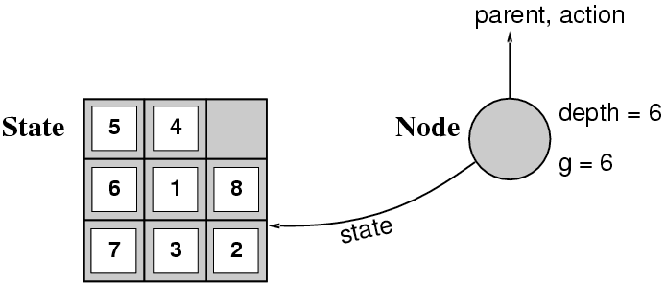
Implementation: states vs. nodes
A state is a (representation of) a physical configuration
A node is a data structure constituting part of a search tree includes state, parent node, action, path cost g(x), depth
The Expand function creates new nodes, filling in the various fields and using the SuccessorFn of the problem to create the corresponding states.
http://aima.eecs.berkeley.edu/slides-ppt/

Slide 69
Evaluation Criteria
completeness
if there is a solution, will it be found
optimality
the best solution will be found
time complexity
time it takes to find the solution
does not include the time to perform actions
space complexity
memory required for the search
main factors for complexity considerations:
branching factor b
depth d of the shallowest goal node
maximum path length m

Slide 70
Search Cost and Path Cost
the search cost indicates how expensive it is to generate a solution
time complexity (e.g. number of nodes generated) is usually the main factor
sometimes space complexity (memory usage) is considered as well
path cost indicates how expensive it is to execute the solution found in the search
distinct from the search cost, but often related
total cost is the sum of search and path costs

Slide 71
Search Strategies
Uninformed
Informed
Local
Others

Slide 72
Selection of a Search Strategy
selection of an appropriate search strategy for a given problem
uninformed search (blind search)
number of steps, path cost unknown
agent knows it is at a goal only after it reaches a goal
goals are not “visible” from a distance
informed search (heuristic search)
agent has background information about the problem
map, costs of actions
hints about the location of the goal
evaluating hints can be costly as well

Slide 73
Search Strategies
Uninformed Search
breadth-first
uniform-cost search
depth-first
depth-limited search
iterative deepening
bi-directional search
Informed Search
best-first search
search with heuristics
memory-bounded search
iterative improvement search
Local Search and Optimization
hill-climbing
simulated annealing
local beam search
genetic algorithms
constraint satisfaction
Search in Continuous Spaces
Non-deterministic Actions
Partial Observations
Online Search

Slide 74
Breadth-First
plain breadth-first
uniform cost

Slide 75
Breadth-First
all the nodes reachable from the current node are explored first
achieved by the TREE-SEARCH method by appending newly generated nodes at the end of the search queue
function BREADTH-FIRST-SEARCH(problem) returns solution
return TREE-SEARCH(problem, FIFO-QUEUE())
Time Complexity | b^{d+1}
Space Complexity | b^{d+1}
Completeness | yes (for finite b)
Optimality | yes (for non-negative path costs)
b | branching factor
d | depth of the tree

Slide 76
Breadth-First Snapshot 1
Initial
1
Visited
Fringe
2
3
Current
Visible
Goal
Fringe: [] + [2,3]
Notes:
The current node [1] already has been removed from the fringe, and the new ones [2,3] will be added.

Slide 77
Breadth-First Snapshot 2
Initial
1
Visited
Fringe
2
3
Current
Visible
Goal
4
5
Fringe: [3] + [4,5]

Slide 78
Breadth-First Snapshot 3
Initial
1
Visited
Fringe
2
3
Current
Visible
Goal
4
5
6
7
Fringe: [4,5] + [6,7]

Slide 79
Breadth-First Snapshot 4
Initial
1
Visited
Fringe
2
3
Current
Visible
Goal
4
5
6
7
8
9
Fringe: [5,6,7] + [8,9]

Slide 80
Breadth-First Snapshot 5
Initial
1
Visited
Fringe
2
3
Current
Visible
Goal
4
5
6
7
8
9
10
11
Fringe: [6,7,8,9] + [10,11]

Slide 81
Breadth-First Snapshot 6
Initial
1
Visited
Fringe
2
3
Current
Visible
Goal
4
5
6
7
8
9
10
11
12
13
Fringe: [7,8,9,10,11] + [12,13]

Slide 82
Breadth-First Snapshot 7
Initial
1
Visited
Fringe
2
3
Current
Visible
Goal
4
5
6
7
8
9
10
11
12
13
14
15
Fringe: [8,9.10,11,12,13] + [14,15]

Slide 83
Breadth-First Snapshot 8
Initial
1
Visited
Fringe
2
3
Current
Visible
Goal
4
5
6
7
8
9
10
11
12
13
14
15
16
17
Fringe: [9,10,11,12,13,14,15] + [16,17]

Slide 84
Breadth-First Snapshot 9
Initial
1
Visited
Fringe
2
3
Current
Visible
Goal
4
5
6
7
8
9
10
11
12
13
14
15
16
17
18
19
Fringe: [10,11,12,13,14,15,16,17] + [18,19]

Slide 85
Breadth-First Snapshot 10
Initial
1
Visited
Fringe
2
3
Current
Visible
Goal
4
5
6
7
8
9
10
11
12
13
14
15
16
17
18
19
20
21
Fringe: [11,12,13,14,15,16,17,18,19] + [20,21]

Slide 86
Breadth-First Snapshot 11
Initial
1
Visited
Fringe
2
3
Current
Visible
Goal
4
5
6
7
8
9
10
11
12
13
14
15
16
17
18
19
20
21
22
23
Fringe: [12, 13, 14, 15, 16, 17, 18, 19, 20, 21] + [22,23]

Slide 87
Breadth-First Snapshot 12
Initial
1
Visited
Fringe
2
3
Current
Visible
Goal
4
5
6
7
Note:
The goal node is “visible” here, but we can not perform the goal test yet.
8
9
10
11
12
13
14
15
16
17
18
19
20
21
22
23
24
25
Fringe: [13,14,15,16,17,18,19,20,21] + [22,23]

Slide 88
Breadth-First Snapshot 13
Initial
1
Visited
Fringe
2
3
Current
Visible
Goal
4
5
6
7
8
9
10
11
12
13
14
15
16
17
18
19
20
21
22
23
24
25
26
27
Fringe: [14,15,16,17,18,19,20,21,22,23,24,25] + [26,27]

Slide 89
Breadth-First Snapshot 14
Initial
1
Visited
Fringe
2
3
Current
Visible
Goal
4
5
6
7
8
9
10
11
12
13
14
15
16
17
18
19
20
21
22
23
24
25
26
27
28
29
Fringe: [15,16,17,18,19,20,21,22,23,24,25,26,27] + [28,29]

Slide 90
Breadth-First Snapshot 15
Initial
1
Visited
Fringe
2
3
Current
Visible
Goal
4
5
6
7
8
9
10
11
12
13
14
15
16
17
18
19
20
21
22
23
24
25
26
27
28
29
30
31
Fringe: [15,16,17,18,19,20,21,22,23,24,25,26,27,28,29] + [30,31]

Slide 91
Breadth-First Snapshot 16
Initial
1
Visited
Fringe
2
3
Current
Visible
Goal
4
5
6
7
8
9
10
11
12
13
14
15
16
17
18
19
20
21
22
23
24
25
26
27
28
29
30
31
Fringe: [17,18,19,20,21,22,23,24,25,26,27,28,29,30,31]

Slide 92
Breadth-First Snapshot 17
Initial
1
Visited
Fringe
2
3
Current
Visible
Goal
4
5
6
7
8
9
10
11
12
13
14
15
16
17
18
19
20
21
22
23
24
25
26
27
28
29
30
31
Fringe: [18,19,20,21,22,23,24,25,26,27,28,29,30,31]

Slide 93
Breadth-First Snapshot 18
Initial
1
Visited
Fringe
2
3
Current
Visible
Goal
4
5
6
7
8
9
10
11
12
13
14
15
16
17
18
19
20
21
22
23
24
25
26
27
28
29
30
31
Fringe: [19,20,21,22,23,24,25,26,27,28,29,30,31]

Slide 94
Breadth-First Snapshot 19
Initial
1
Visited
Fringe
2
3
Current
Visible
Goal
4
5
6
7
8
9
10
11
12
13
14
15
16
17
18
19
20
21
22
23
24
25
26
27
28
29
30
31
Fringe: [20,21,22,23,24,25,26,27,28,29,30,31]

Slide 95
Breadth-First Snapshot 20
Initial
1
Visited
Fringe
2
3
Current
Visible
Goal
4
5
6
7
8
9
10
11
12
13
14
15
16
17
18
19
20
21
22
23
24
25
26
27
28
29
30
31
Fringe: [21,22,23,24,25,26,27,28,29,30,31]

Slide 96
Breadth-First Snapshot 21
Initial
1
Visited
Fringe
2
3
Current
Visible
Goal
4
5
6
7
8
9
10
11
12
13
14
15
16
17
18
19
20
21
22
23
24
25
26
27
28
29
30
31
Fringe: [22,23,24,25,26,27,28,29,30,31]

Slide 97
Breadth-First Snapshot 22
Initial
1
Visited
Fringe
2
3
Current
Visible
Goal
4
5
6
7
8
9
10
11
12
13
14
15
16
17
18
19
20
21
22
23
24
25
26
27
28
29
30
31
Fringe: [23,24,25,26,27,28,29,30,31]

Slide 98
Breadth-First Snapshot 23
Initial
1
Visited
Fringe
2
3
Current
Visible
Goal
4
5
6
7
8
9
10
11
12
13
14
15
16
17
18
19
20
21
22
23
24
25
26
27
28
29
30
31
Fringe: [24,25,26,27,28,29,30,31]

Slide 99
Breadth-First Snapshot 24
Initial
1
Visited
Fringe
2
3
Current
Visible
Goal
4
5
6
7
Note:
The goal test is positive for this node, and a solution is found in 24 steps.
8
9
10
11
12
13
14
15
16
17
18
19
20
21
22
23
24
25
26
27
28
29
30
31
Fringe: [25,26,27,28,29,30,31]

Slide 100
Uniform-Cost -First
the nodes with the lowest cost are explored first
similar to BREADTH-FIRST, but with an evaluation of the cost for each reachable node
g(n) = path cost(n) = sum of individual edge costs to reach the current node
function UNIFORM-COST-SEARCH(problem) returns solution
return TREE-SEARCH(problem, COST-FN, FIFO-QUEUE())
Time Complexity | b^{C*/e}
Space Complexity | b^{C*/e}
Completeness | yes (finite b, step costs >= e)
Optimality | yes
b | branching factor
C* | cost of the optimal solution
e | minimum cost per action

Slide 101
Uniform-Cost Snapshot
Initial
1
Visited
4
3
Fringe
2
3
Current
Visible
7
2
2
4
Goal
4
5
6
7
Edge Cost
9
2
5
4
4
4
3
6
9
8
9
10
11
12
13
14
15
3
4
7
2
4
8
6
5
4
3
4
2
8
3
9
2
16
17
18
19
20
21
22
23
24
25
26
27
28
29
30
31
Fringe: [27(10), 4(11), 25(12), 26(12), 14(13), 24(13), 20(14), 15(16), 21(18)]
+ [22(16), 23(15)]

Slide 102
Uniform Cost Fringe Trace
[1(0)]
[3(3), 2(4)]
[2(4), 6(5), 7(7)]
[6(5), 5(6), 7(7), 4(11)]
[5(6), 7(7), 13(8), 12(9), 4(11)]
[7(7), 13(8), 12(9), 10(10), 11(10), 4(11)]
[13(8), 12(9), 10(10), 11(10), 4(11), 14(13), 15(16)]
[12(9), 10(10), 11(10), 27(10), 4(11), 26(12), 14(13), 15(16)]
[10(10), 11(10), 27(10), 4(11), 26(12), 25(12), 14(13), 24(13), 15(16)]
[11(10), 27(10), 4(11), 25(12), 26(12), 14(13), 24(13), 20(14), 15(16), 21(18)]
[27(10), 4(11), 25(12), 26(12), 14(13), 24(13), 20(14), 23(15), 15(16), 22(16), 21(18)]
[4(11), 25(12), 26(12), 14(13), 24(13), 20(14), 23(15), 15(16), 23(16), 21(18)]
[25(12), 26(12), 14(13), 24(13),8(13), 20(14), 23(15), 15(16), 23(16), 9(16), 21(18)]
[26(12), 14(13), 24(13),8(13), 20(14), 23(15), 15(16), 23(16), 9(16), 21(18)]
[14(13), 24(13),8(13), 20(14), 23(15), 15(16), 23(16), 9(16), 21(18)]
[24(13),8(13), 20(14), 23(15), 15(16), 23(16), 9(16), 29(16),21(18), 28(21)]
Goal reached!
Notation: [Bold+Yellow: Current Node; White: Old Fringe Node; Green+Italics: New Fringe Node].
Assumption: New nodes with the same cost as existing nodes are added after the existing node.

Slide 103
Breadth-First vs.
Uniform-Cost
breadth-first always expands the shallowest node
only optimal if all step costs are equal
uniform-cost considers the overall path cost
optimal for any (reasonable) cost function
non-zero, positive
gets bogged down in trees with many fruitless, short branches
low path cost, but no goal node
both are complete for non-extreme problems
finite number of branches
strictly positive cost function

Slide 104
Review:
Breadth-First vs. Uniform-Cost
basic idea:
breadth-first
uniform-cost
properties
completeness
optimality
time complexity
space complexity

Slide 105
Depth-First
plain depth-first
limited depth
iterative deepening

Slide 106
Depth-First
continues exploring newly generated nodes
achieved by the TREE-SEARCH method by appending newly generated nodes at the beginning of the search queue
utilizes a Last-In, First-Out (LIFO) queue, or stack
function DEPTH-FIRST-SEARCH(problem) returns solution
return TREE-SEARCH(problem, LIFO-QUEUE())
Time Complexity | b^{m}
Space Complexity | b*m
Completeness | no (for infinite branch length)
Optimality | no
b | branching factor
m | maximum path length

Slide 107
Depth-First Snapshot
Initial
1
Visited
Fringe
2
3
Current
Visible
Goal
4
5
6
7
8
9
10
11
12
13
14
15
16
17
18
19
20
21
22
23
24
25
26
27
28
29
30
31
Fringe: [3] + [22,23]

Slide 108
Depth-First vs. Breadth-First
depth-first goes off into one branch until it reaches a leaf node
not good if the goal is on another branch
neither complete nor optimal
uses much less space than breadth-first
much fewer visited nodes to keep track of
smaller fringe
breadth-first is more careful by checking all alternatives
complete and optimal
under most circumstances
very memory-intensive

Slide 109
Backtracking Search
variation of depth-first search
only one successor node is generated at a time
even better space complexity: O(m) instead of O(b*m)
even more memory space can be saved by incrementally modifying the current state, instead of creating a new one
only possible if the modifications can be undone
this is referred to as backtracking
frequently used in planning, theorem proving

Slide 110
Logistics
Class Visit Section 1: Adam Rizkalla
internship working at Emotiv on BCI devices
AI Nugget presentations
proposals and past presentations mostly graded
Section 1:
George Donegan: Zeno Robot Boy
Elizabeth Loui: Facial Recognition In Robots
Ethan Frame: Nest Thermostat
Section 3:
Stephanie Krapil: DARPA urban challenge
Austin Dworaczyk Wiltshire: Virtual Human Diagnosis
Assignments
A1: Search Algorithms
uniform cost, best-first (greedy), A*
A3: Robocode, Prisoner’s Dilemma, alternatives
Lab submission deadlines fixed: Tue, end of day (not end of lab)
Quiz 3 available all day Tue, Oct. 9
Make-up question details TBA soon; most likely
submission formats: Web form, tab-delimited, NL-delimited
2 submitted questions are the equivalent of one quiz questions (10 points)

Slide 111
Depth-Limited Search
similar to depth-first, but with a limit
overcomes problems with infinite paths
sometimes a depth limit can be inferred or estimated from the problem description
in other cases, a good depth limit is only known when the problem is solved
based on the TREE-SEARCH method
must keep track of the depth
function DEPTH-LIMITED-SEARCH(problem, depth-limit) returns solution
return TREE-SEARCH(problem, depth-limit, LIFO-QUEUE())
Time Complexity | b^{l}
Space Complexity | b*l
Completeness | no (goal beyond l, or infinite branch length)
Optimality | no
b | branching factor
l | depth limit

Slide 112
Iterative Deepening
applies LIMITED-DEPTH with increasing depth limits
combines advantages of BREADTH-FIRST and DEPTH-FIRST methods
many states are expanded multiple times
doesn’t really matter because the number of those nodes is small
in practice, one of the best uninformed search methods
for large search spaces, unknown depth
function ITERATIVE-DEEPENING-SEARCH(problem) returns solution
for depth := 0 to unlimited do
result := DEPTH-LIMITED-SEARCH(problem, depth-limit)
if result != cutoff then return result
Time Complexity | b^{d}
Space Complexity | b*d
Completeness | yes (finite b)
Optimality | yes (all step costs identical)
b | branching factor
d | tree depth

Slide 113
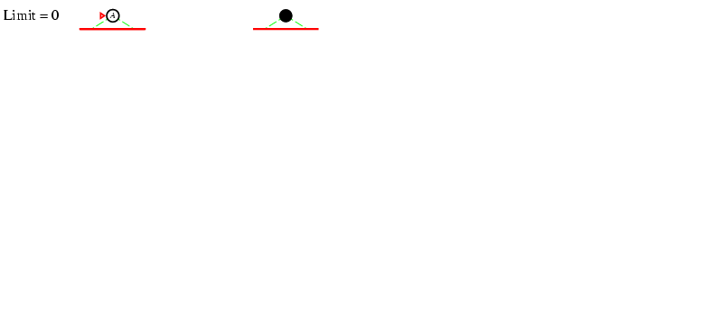
Iterative deepening search l =0

Slide 114
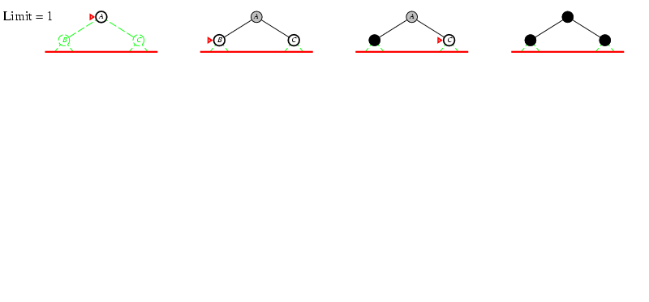
Iterative deepening search l =1

Slide 115
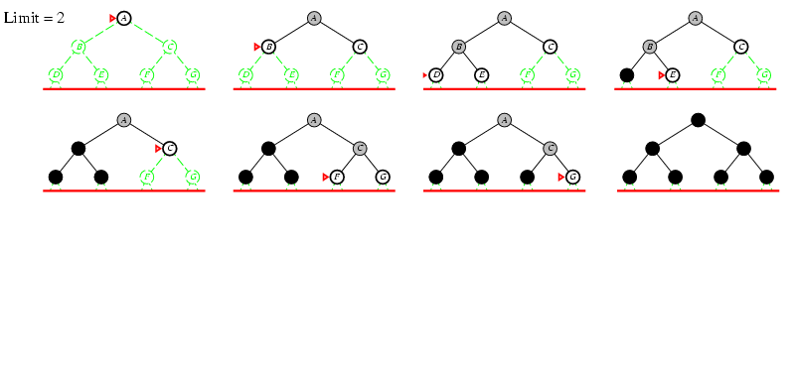
Iterative deepening search l =2

Slide 116
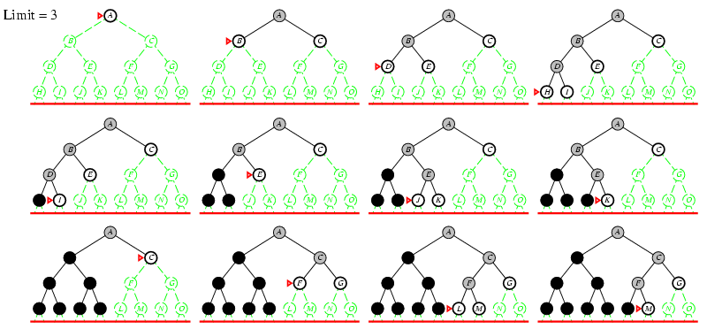
Iterative deepening search l =3

Slide 117
Iterative deepening search
Number of nodes generated in a depth-limited search to depth d with branching factor b:
N_{DLS} = b⁰ + b¹ + b² + … + b^{d-2} + b^{d-1} + b^{d}
Number of nodes generated in an iterative deepening search to depth d with branching factor b:
N_{IDS} = (d+1)b⁰ + d b^¹ + (d-1)b^² + … + 3b^{d-2} +2b^{d-1} + 1b^{d}
For b = 10, d = 5,
N_{DLS} = 1 + 10 + 100 + 1,000 + 10,000 + 100,000 = 111,111
N_{IDS} = 6 + 50 + 400 + 3,000 + 20,000 + 100,000 = 123,456
Overhead = (123,456 - 111,111)/111,111 = 11%

Slide 118
Bi-directional Search
search simultaneously from two directions
forward from the initial and backward from the goal state
may lead to substantial savings if it is applicable
has severe limitations
predecessors must be generated, which is not always possible
search must be coordinated between the two searches
one search must keep all nodes in memory
Time Complexity | b^{d/2}
Space Complexity | b^{d/2}
Completeness | yes (b finite, breadth-first for both directions)
Optimality | yes (all step costs identical, breadth-first for both directions)
b | branching factor
d | tree depth

Slide 119
Improving Search Methods
assumption for improvements
remember information about the search so far
all nodes visited so far
path to the current node
make algorithms more efficient
avoiding repeated states
utilizing memory efficiently
use additional knowledge about the problem
properties (“shape”) of the search space
more interesting areas are investigated first
pruning of irrelevant areas
areas that are guaranteed not to contain a solution can be discarded

Slide 120
Avoiding Repeated States
in many approaches, states may be expanded multiple times
e.g. iterative deepening
problems with reversible actions
eliminating repeated states may yield an exponential reduction in search cost
e.g. some n-queens strategies
place queen in the left-most non-threatening column
rectangular grid
4^{d} leaves, but only 2^{d2} distinct states

Slide 121
Logistics 1
Labs
L3 demos in lab on Thu, Tue
L4: AI in Entertainment (e.g. Games, Movies) out, due Tue, Oct. 22
Project
documentation in poor shape overall
mid-quarter project display date: Thu, Oct 31
known conflicts?
costumes optional ;-)
Assignments
A1: Search Algorithms available, deadline Thu, Oct. 24
uniform cost, best-first (greedy), A*
Munich Exchange Opportunities
deadline extended to Nov. 1
joint Senior Project/Master’s Thesis topics
Correlation Tracking in Image Sequences as Smartphone App
HIL Simulation for Smartphone-guided Autonomous Systems

Slide 122
Logistics 2
AI Nugget presentations
Section 1
Christine Pham: The Netflix Prize (Tue carry-over)
Kevin Green: Computer Chess - From Deep Blue to the Current Era
Eric Thorndyke: Evolutionary Design and CAD Simulations
Nicolas Higuera: Quadcopters & Swarm Intelligence
Section 3
Stephen Hill: Natural Language Processing (Tue carry-over)
Jimmy Noehren: Autonomous Drones
(Tue carry-over from Section 1; lab)

Slide 123
Informed Search
Best-first
Greedy best-first
A*
A* modifications

Slide 124
Informed Search
relies on additional knowledge about the problem or domain
frequently expressed through heuristics (“rules of thumb”)
used to distinguish more promising paths towards a goal
may be mislead, depending on the quality of the heuristic
in general, performs much better than uninformed search
but frequently still exponential in time and space for realistic problems

Slide 125
Best-First Search
relies on an evaluation function that gives an indication of how useful it would be to expand a node
family of search methods with various evaluation functions
usually gives an estimate of the distance to the goal
often referred to as heuristics in this context
the node with the lowest value is expanded first
the name is a little misleading: the node with the lowest value for the evaluation function is not necessarily one that is on an optimal path to a goal
if we really know which one is the best, there’s no need to do a search
function BEST-FIRST-SEARCH(problem, EVAL-FN) returns solution
fringe := queue with nodes ordered by EVAL-FN
return TREE-SEARCH(problem, fringe)

Slide 126

Greedy Best-First Search
minimizes the estimated cost to a goal
expand the node that seems to be closest to a goal
utilizes a heuristic function as evaluation function
f(n) = h(n) = estimated cost from the current node to a goal
heuristic functions are problem-specific
often straight-line distance for route-finding and similar problems
often better than depth-first, although worst-time complexities are equal or worse (space)
function GREEDY-SEARCH(problem) returns solution
return BEST-FIRST-SEARCH(problem, h)

Slide 127
Greedy Best-First Search Snapshot
Initial
1
9
Visited
Fringe
2
7
3
7
Current
Visible
Goal
4
6
5
5
6
5
7
6
Heuristics
7
8
7
9
5
10
4
11
3
12
2
13
4
14
5
15
6
8
7
6
5
4
3
2
1
0
1
2
3
4
5
6
7
16
17
18
19
20
21
22
23
24
25
26
27
28
29
30
31
Fringe: [13(4), 7(6), 8(7)] + [24(0), 25(1)]

Slide 128
Logistics
Senior Project working with Emotiv (Adam Rizkalla) on using BCI devices for adaptive music playlists
AI Nugget presentations
proposals and past presentations mostly graded
Section 1:
Stephen Calabrese: Wolfram Alpha
Brandon Page: Google Now
Adin Miller: AI System Builds Video Games
Section 3:
Luke Larson: Crusher
Jorge Mendoza: Behind IBM’s Watson
Bot/WumpusEnvironment
source code, JavaDocs for WumpusEnvironment is on PolyLearn
post insights of potential interest for others on the PolyLearn forum

Slide 129

A* Search
combines greedy and uniform-cost search to find the (estimated) cheapest path through the current node
f(n) = g(n) + h(n) = path cost + estimated cost to the goal
heuristics must be admissible
never overestimate the cost to reach the goal
very good search method, but with complexity problems
function A*-SEARCH(problem) returns solution
return BEST-FIRST-SEARCH(problem, g+h)

Slide 130
A* Snapshot
9
Initial
1
9
Visited
4
3
Fringe
11
10
2
7
3
7
Current
Visible
7
2
2
4
Goal
10
13
4
6
5
5
6
5
7
6
Edge Cost
9
2
5
4
4
4
3
6
9
Heuristics
11
12
7
8
7
9
5
10
4
11
3
12
2
13
4
14
5
15
6
f-cost
10
3
4
7
2
4
8
6
5
4
3
4
2
8
3
9
2
13
13
8
7
6
5
4
3
2
1
0
1
2
3
4
5
6
7
16
17
18
19
20
21
22
23
24
25
26
27
28
29
30
31
Fringe: [2(4+7), 13(3+2+3+4), 7(3+4+6)] + [24(3+2+4+4+0), 25(3+2+4+3+1)]

Slide 131
A* Snapshot with all f-Costs
Initial
1
9
Visited
4
3
Fringe
11
10
2
7
3
7
Current
Visible
7
2
2
4
Goal
17
11
10
13
4
6
5
5
6
5
7
6
Edge Cost
9
2
5
4
4
4
3
6
9
Heuristics
20
21
14
13
11
12
18
22
7
8
7
9
5
10
4
11
3
12
2
13
4
14
5
15
6
f-cost
10
3
4
7
2
4
8
6
5
4
3
4
2
8
3
9
2
24
24
29
23
18
19
18
16
13
13
14
13
25
21
31
25
8
7
6
5
4
3
2
1
0
1
2
3
4
5
6
7
16
17
18
19
20
21
22
23
24
25
26
27
28
29
30
31

Slide 132
A* Properties
the value of f never decreases along any path starting from the initial node
also known as monotonicity of the function
almost all admissible heuristics show monotonicity
those that don’t can be modified through minor changes
this property can be used to draw contours
regions where the f-cost is below a certain threshold
with uniform cost search (h = 0), the contours are circular
the better the heuristics h, the narrower the contour around the optimal path

Slide 133
A* Snapshot with Contour f=11
Initial
1
9
Visited
4
3
Fringe
11
10
2
7
3
7
Current
Visible
7
2
2
4
Goal
17
11
10
13
4
6
5
5
6
5
7
6
Edge Cost
9
2
5
4
4
4
3
6
9
Heuristics
20
21
14
13
11
12
18
22
7
8
7
9
5
10
4
11
3
12
2
13
4
14
5
15
6
f-cost
10
3
4
7
2
4
8
6
5
4
3
4
2
8
3
9
2
24
24
29
23
18
19
18
16
13
13
14
13
25
21
31
25
Contour
8
7
6
5
4
3
2
1
0
1
2
3
4
5
6
7
16
17
18
19
20
21
22
23
24
25
26
27
28
29
30
31

Slide 134
A* Snapshot with Contour f=13
Initial
1
9
Visited
4
3
Fringe
11
10
2
7
3
7
Current
Visible
7
2
2
4
Goal
17
11
10
13
4
6
5
5
6
5
7
6
Edge Cost
9
2
5
4
4
4
3
6
9
Heuristics
20
21
14
13
11
12
18
22
7
8
7
9
5
10
4
11
3
12
2
13
4
14
5
15
6
f-cost
10
3
4
7
2
4
8
6
5
4
3
4
2
8
3
9
2
24
24
29
23
18
19
18
16
13
13
13
25
21
31
25
Contour
8
7
6
5
4
3
2
1
0
1
3
4
5
6
7
16
17
18
19
20
21
22
23
24
25
14
27
28
29
30
31
2
26

Slide 135
Optimality of A*
A* will find the optimal solution
the first solution found is the optimal one
A* is optimally efficient
no other algorithm is guaranteed to expand fewer nodes than A*
A* is not always “the best” algorithm
optimality refers to the expansion of nodes
other criteria might be more relevant
it generates and keeps all nodes in memory
improved in variations of A*

Slide 136
Complexity of A*
the number of nodes within the goal contour search space is still exponential
with respect to the length of the solution
better than other algorithms, but still problematic
frequently, space complexity is more severe than time complexity
A* keeps all generated nodes in memory

Slide 137
Memory-Bounded Search
search algorithms that try to conserve memory
most are modifications of A*
iterative deepening A* (IDA*)
simplified memory-bounded A* (SMA*)

Slide 138
Iterative Deepening A* (IDA*)
explores paths within a given contour (f-cost limit) in a depth-first manner
this saves memory space because depth-first keeps only the current path in memory
but it results in repeated computation of earlier contours since it doesn’t remember its history
was the “best” search algorithm for many practical problems for some time
does have problems with difficult domains
contours differ only slightly between states
algorithm frequently switches back and forth
similar to disk thrashing in (old) operating systems

Slide 139
Recursive Best-First Search
similar to best-first search, but with lower space requirements
O(bd) instead of O(bm)
it keeps track of the best alternative to the current path
best f-value of the paths explored so far from predecessors of the current node
if it needs to re-explore parts of the search space, it knows the best candidate path
still may lead to multiple re-explorations

Slide 140
Simplified Memory-Bounded A* (SMA*)
uses all available memory for the search
drops nodes from the queue when it runs out of space
those with the highest f-costs
avoids re-computation of already explored area
keeps information about the best path of a “forgotten” subtree in its ancestor
complete if there is enough memory for the shortest solution path
often better than A* and IDA*
but some problems are still too tough
trade-off between time and space requirements

Slide 141
Heuristics for Searching
for many tasks, a good heuristic is the key to finding a solution
prune the search space
move towards the goal
relaxed problems
fewer restrictions on the successor function (operators)
its exact solution may be a good heuristic for the original problem

Slide 142
8-Puzzle Heuristics
level of difficulty
around 20 steps for a typical solution
branching factor is about 3
exhaustive search would be 320 = 3.5 * 109
9!/2 = 181,440 different reachable states
distinct arrangements of 9 squares
candidates for heuristic functions
number of tiles in the wrong position
sum of distances of the tiles from their goal position
city block or Manhattan distance
generation of heuristics
possible from formal specifications

Slide 143
Admissible heuristics
E.g., for the 8-puzzle:
h1(n) = number of misplaced tiles
h2(n) = total Manhattan distance
(i.e., no. of squares from desired location of each tile)
h1(S) = ? 8
h2(S) = ? 3+1+2+2+2+3+3+2 = 18
http://aima.eecs.berkeley.edu/slides-ppt/

Slide 144
Post-Test
Notes:
evaluate the learning success of the participants
provide feedback to the students about their achievements
ask for feedback on unclear or difficult parts
point out possible gaps and difficulties
encourage suggestions for improvement

Slide 145
Evaluation
Criteria

Slide 146
Important Concepts and Terms
agent
A* search
best-first search
bi-directional search
breadth-first search
depth-first search
depth-limited search
completeness
constraint satisfaction
depth-limited search
genetic algorithm
general search algorithm
goal
goal test function
greedy best-first search
heuristics
initial state
iterative deepening search
iterative improvement
local search
memory-bounded search
operator
optimality
path
path cost function
problem
recursive best-first search
search
space complexity
state
state space
time complexity
uniform-cost search

Slide 147
Chapter Summary
tasks can often be formulated as search problems
initial state, successor function (operators), goal test, path cost
various search methods systematically comb the search space
uninformed search
breadth-first, depth-first, and variations
informed search
best-first, A*, iterative improvement
the choice of good heuristics can improve the search dramatically
task-dependent

